Slide 1
Beyond the Buzz
Integrating ai solutions into human-centric strategic planning
January 23, 2025
1:00 – 2:00 PM (ET)
Notes:
Logo library

Slide 2
Some Housekeeping Reminders
Please ensure that you are muted during the session
Use the chat for questions during the session
We’ll track them and check in periodically
There will be time for Q&A – feel free to raise your hand to ask a question, or use chat
Meeting will be recorded and will be summarized using AI
Mute
Camera
Raise Hand
Chat

Slide 3
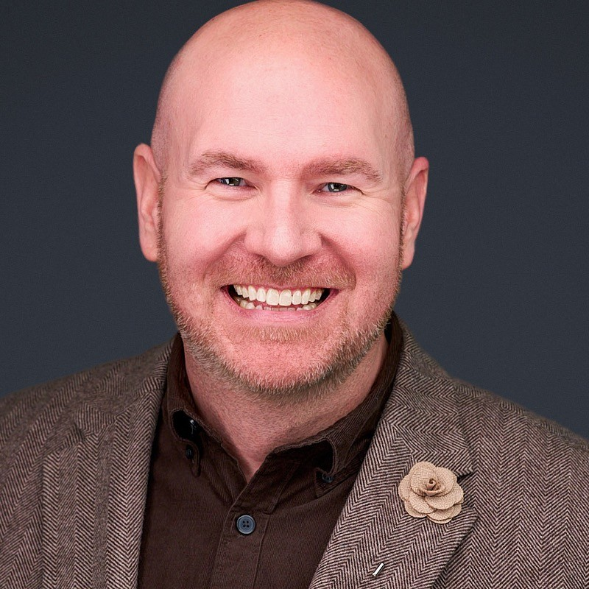
Aaron Wolowiec
President & Founder, Event Garde LLC
Our focus: associations, societies, non-profit organizations, and government agencies across the United States. We transform your learning, meetings and facilitated sessions.
Aaron is nationally recognized for his learning, meetings, and facilitation work with boards, volunteers, members, and staff.
Aaron lives in Dallas, TX, with his husband, Trevor, and his mini goldendoodle, Luca.
When not working, Aaron loves walking, reading, and listening to true crime podcasts.
Notes:
LinkedIn links in the chat: https://www.linkedin.com/in/aaronwolowiec/

Slide 4
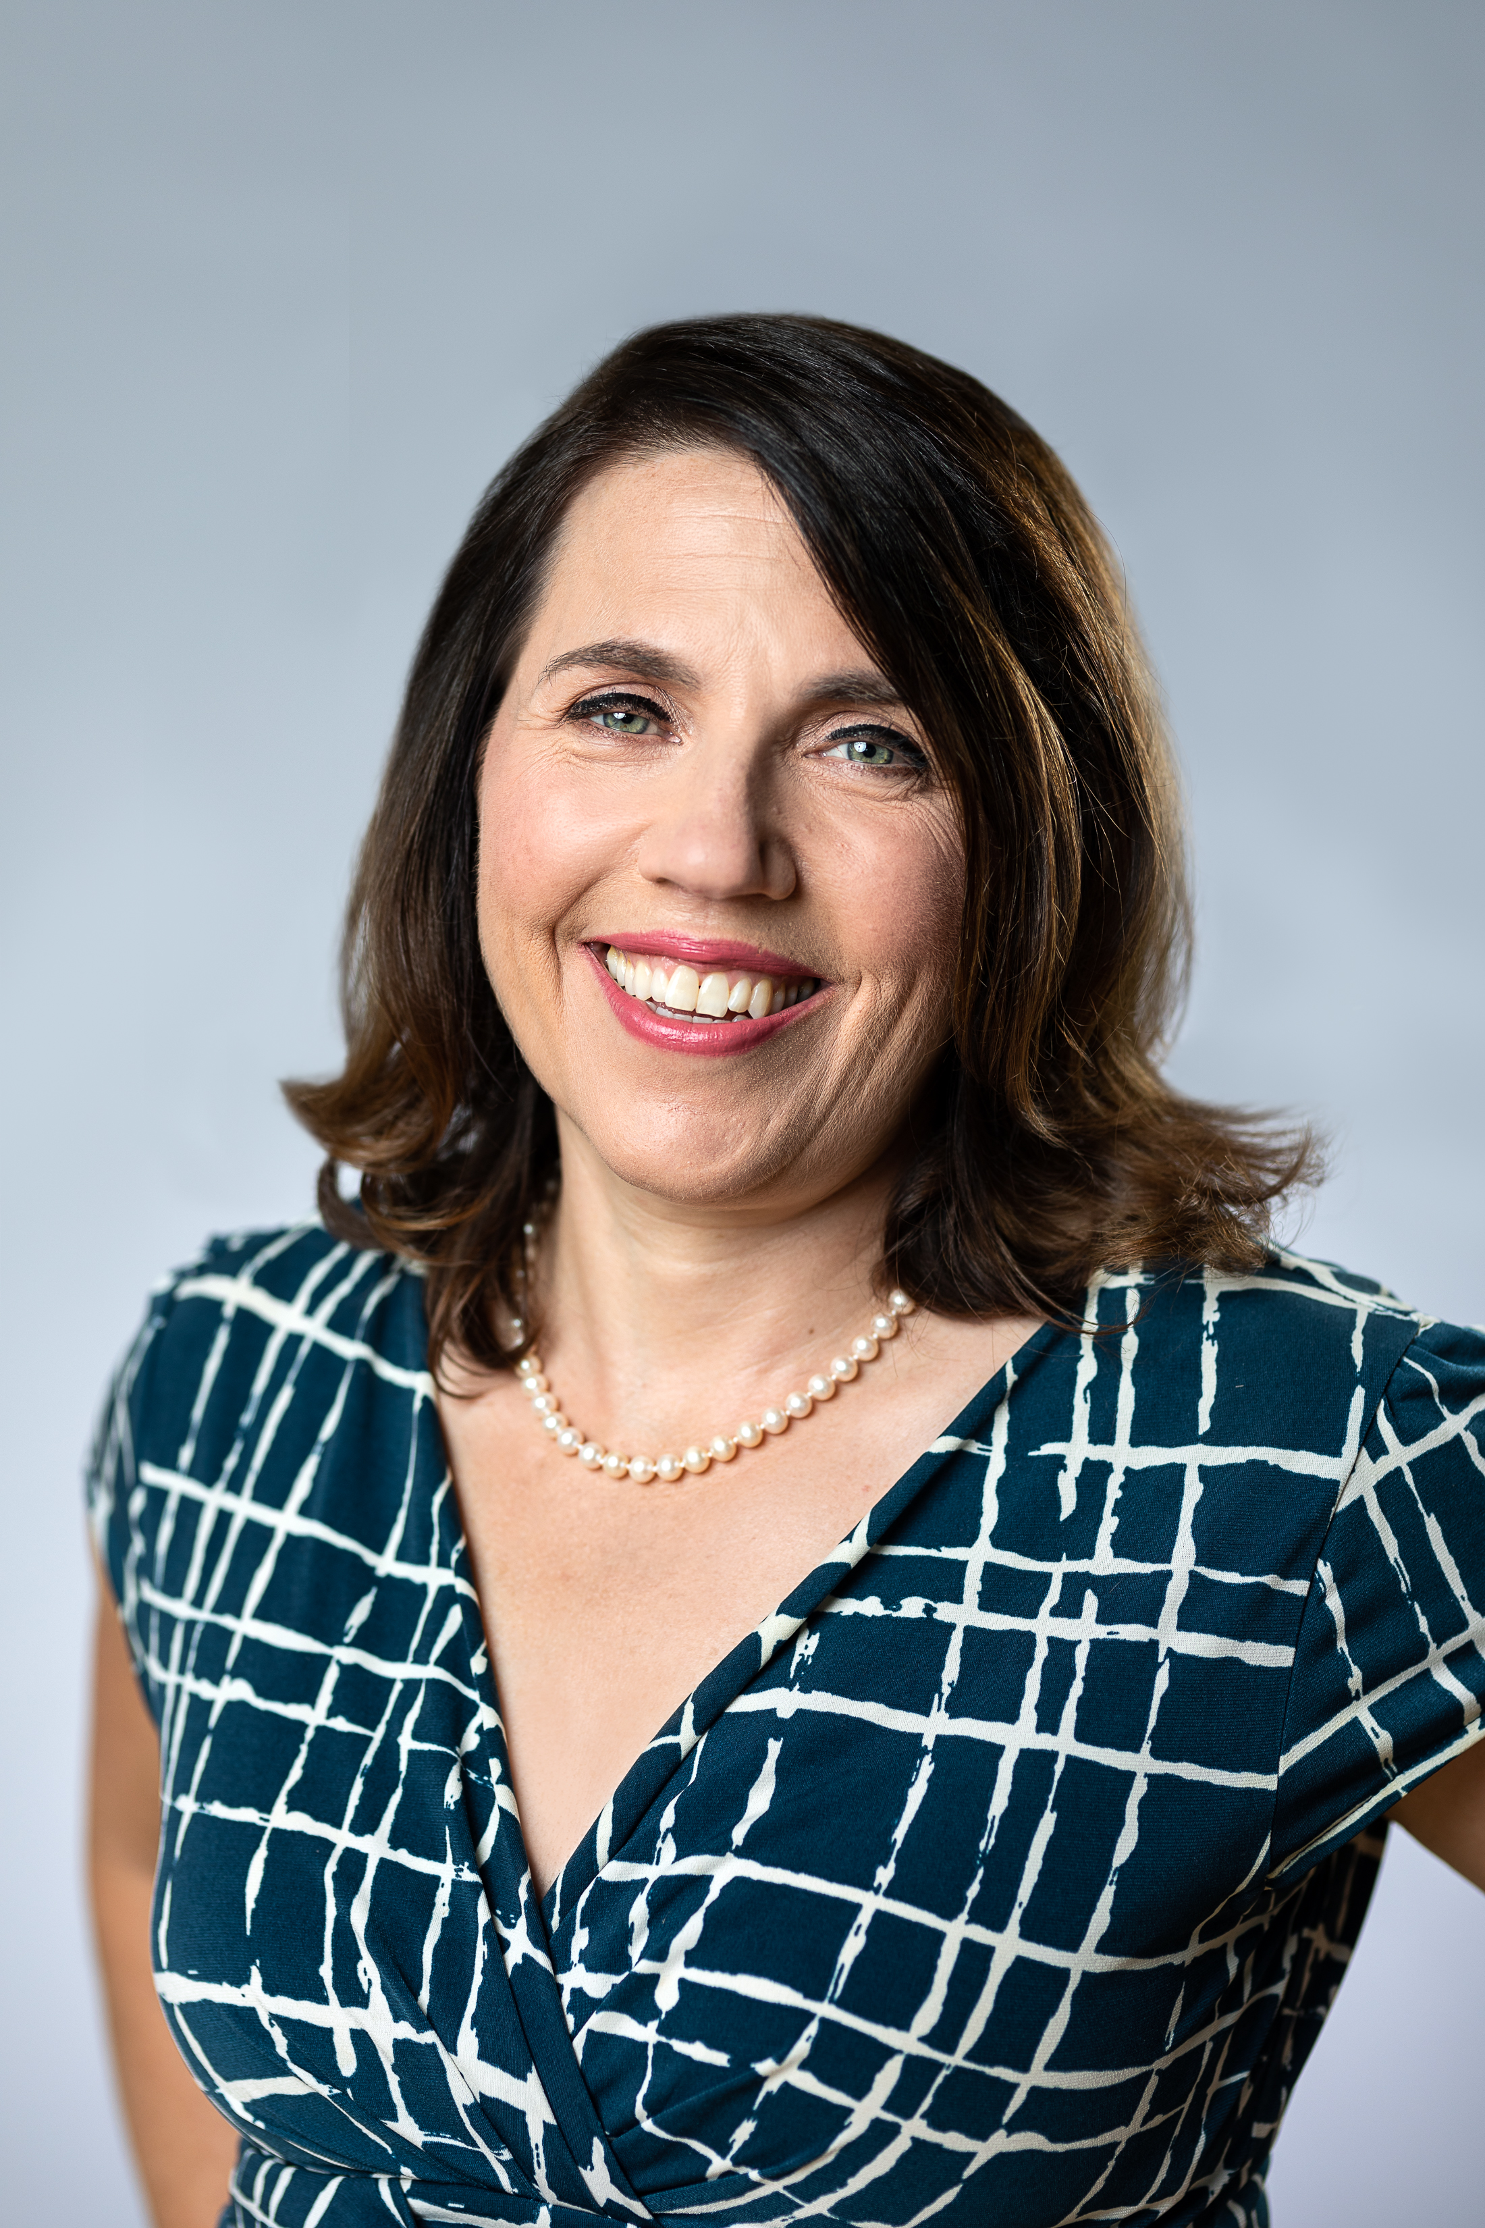
Christine Saunders
President & Founder, Halmyre
Our focus: North American associations, regulators and public institutions. We are experts on value proposition, pricing, and voice of the future member strategies.
Christine is a consultant and award-winning speaker on growth strategy for associations and other non-profits.
Philosophy major (politics and ethics), entrepreneur, teacher, consultant and hobby farmer
2 dogs, 1 cat, some chickens and a husband!
Notes:
LinkedIn links in the chat: CDS https://www.linkedin.com/in/christinedsaunders/

Slide 5
AI Solutions With a Member-Centric Approach
Today’s agenda:
Discover how AI can enhance your understanding of member needs and preferences.
Ensure genuine member insights power your strategic planning process.
Facilitate discussion amongst association peers
Active Q & A to explore together and deepen understanding
Summary of key take-aways

Slide 6
Interactive Discussion

Slide 7
Key Takeaways
AI in Action
Focus on Strategic Alignment: Apply AI to refine strategic goals—for example, using trend analysis tools to align initiatives with emerging industry challenges and member needs.
Maintain Human Leadership: Use AI to generate ideas or draft communications but rely on human leaders for final decision-making and ensuring alignment with your association's vision.
Start Small, Scale Strategically: Pilot AI in one part of the planning process, such as creating competitive scans, before expanding to other areas like forecasting or operational planning.
Transform Strategy Into Action: After defining strategic goals, use AI tools to help break them into operational tasks—for example, creating detailed project plans based on a strategic roadmap.
Challenge your Consultants: They should be leveraging AI for efficiency (e.g., data analysis) AND to disrupt traditional strategic planning thinking and processes – and pricing!
Use Caution with Sensitive Info: Think twice before entering confidential or personal information into open platforms such as ChatGPT. Ask your consultants what platforms they will be using.

Slide 8
Some of the Tools We Mentioned (and some we didn’t!)
Not comprehensive, but some tools we use ourselves, or know of:
ChatGPT, Gemini, Copilot – general content support, data analysis, drafting support (not private)
Google NotebookLM – Private information synthesis and summary
Note-taking software – e.g., Fathom, Zoom’s AI assistant, Otter.ai, Gemini, dozens others
BettyBot – ChatBots customized for Association knowledge bases (collect member feedback, questions)
Open text analysis tools (IBM Watson, Lexalytics)
Data analysis (SurveyMonkey AI, Tableau/Power BI)
Graphic design/marketing (Canva, Sprout Social, Semrush)
Directory of AI tools: https://www.futurepedia.io/ai-tools
Bottom line: many familiar tech tools are incorporating native AI – it’s becoming standard

Slide 9
Halmyre.ai Alpha Test Opportunity
Hally – an Association Growth Strategy AI Tool
Seeking volunteers!
Details to follow in the post-webinar email

Slide 10
In Closing
In Closing

Slide 11
Evaluation and CAE Recognition
CPD Credits (Can/US) or Exam Prep (US)
In-person attendees
Certificates will be sent to attendees on request
Please complete our webinar evaluation and help us serve you better (link in the chat)
Recording viewers:
Test questions available on request
Certificate sent after successful test completion
To request certificates and test questions:
Gabrielle Pribluda:
gpribluda@halmyre.com

Slide 12
Upcoming Events
Event Garde
Halmyre
ToP Gathering, Feb. 20, 2025 (with Halmyre)
Spring 2025 FACILIT8me: Association Facilitator Certificate Course, March 10-May 29, 2025
EG Community Webinar on DEIB, March 12, 2025
Fall 2025 FACILIT8me: Association Facilitator Certificate Course, Sept. 4-Nov. 20, 2025
CSAE CEO Symposium, Jan. 28-29, Mississauga, ON (Sponsor)
Association Forum Women’s Executive Forum, March 7, 2025, Chicago (Exhibitor)
Halmyre Webinar – March 19, 2025 (Topic TBC)

Slide 13
In Closing
Thank you!
See you next time.

